Slide 1


LGE Internal Use Only
IRON FASHION
Le Thi Thanh Tuyen
Nguyen Van Hoang
Nguyen Vo Khanh Toan
2024. 04 . 10
Notes:
Hi, everyone.
Let me introduce myself. My name is “Tuyen”
Today I am here to talk about our company and promote our product to you.
"Our company, [IRON FASHION], includes me, Hoang and Toan. With a focus on innovation and quality, we believe that our product will change the world. Welcome to our [IRON FASHION]!"

Slide 2
LGE Internal Use Only
AGENDA
Product Introduction
Customers
Product Features
Selling Points
Q&A
Notes:
Our presentation is divided into 5 parts.
First
Second
…
Finally

Slide 3
I. Product Introduction
LGE Internal Use Only
Notes:
"Based on the company name, can you guys guess what our product is?“
I'd like to introduce our unique product that I believe will capture the interest of all investors. With maximum protection and unlimited flexibility, this iron suit is not only a world-saving machine but also a profit-generating product in today's market. We invite investors to join with us on this journey and together turn dreams come true

Slide 4
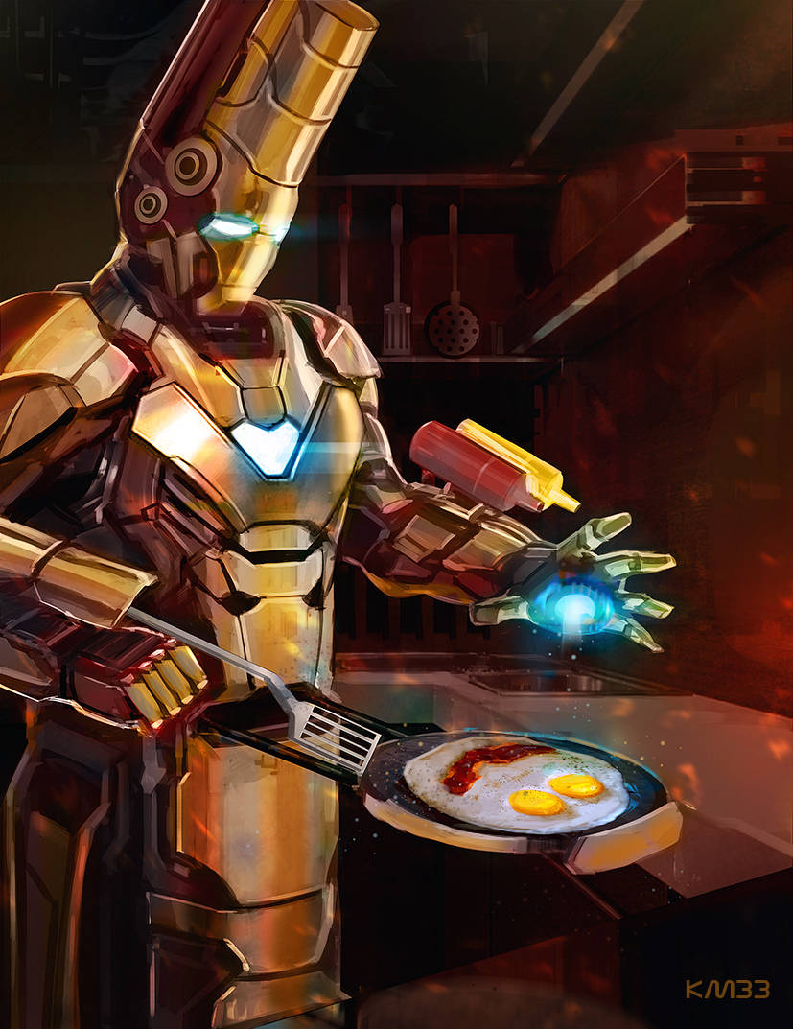
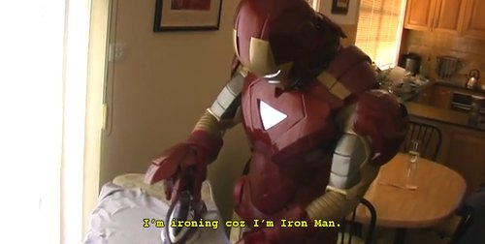
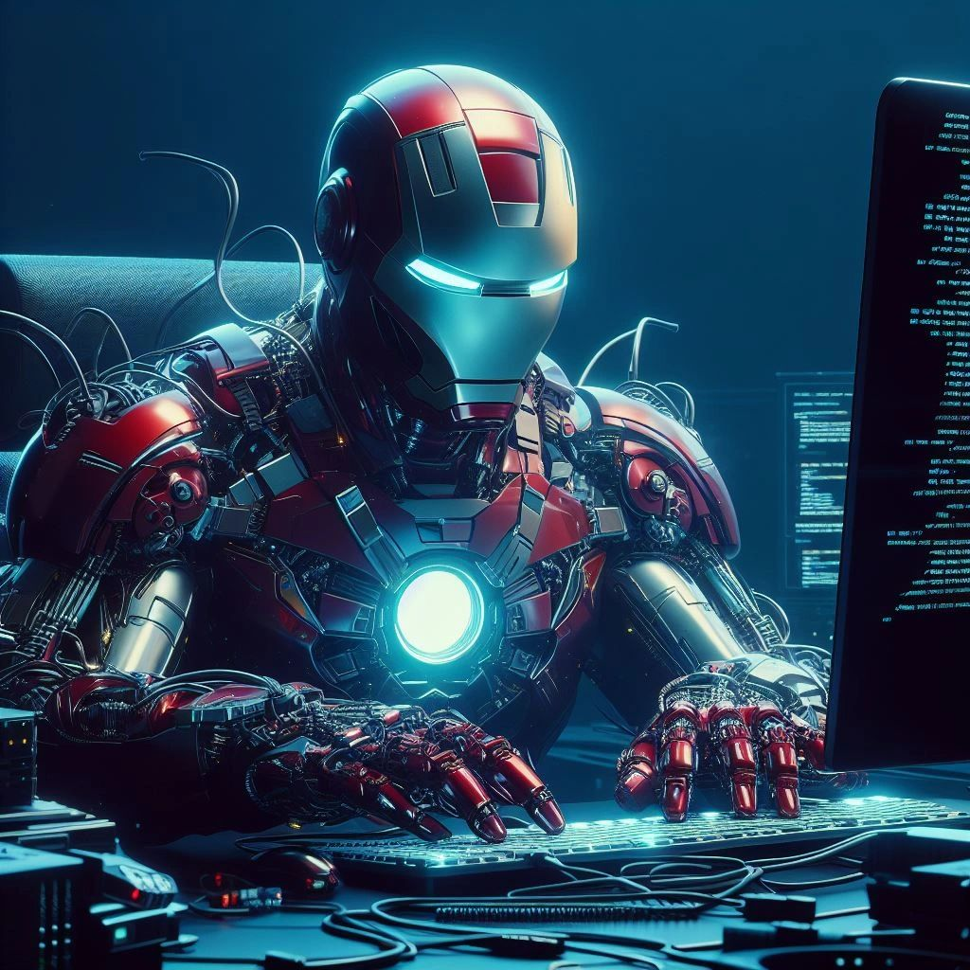
II. Customers
LGE Internal Use Only
Notes:
Who will need this product, and for what purpose will it be used?
It's a waste to just use this product like that

Slide 5
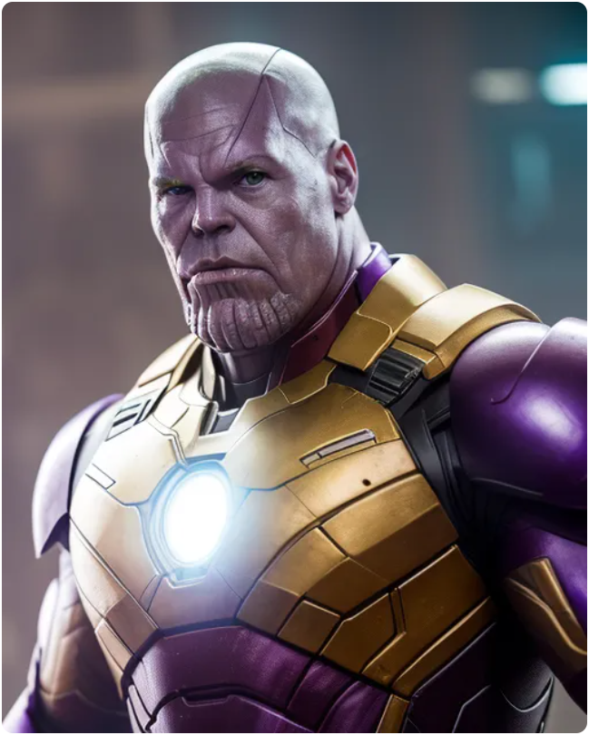
II. Customers
LGE Internal Use Only
Notes:
What happen if this product is sold to the bad guys?

Slide 6
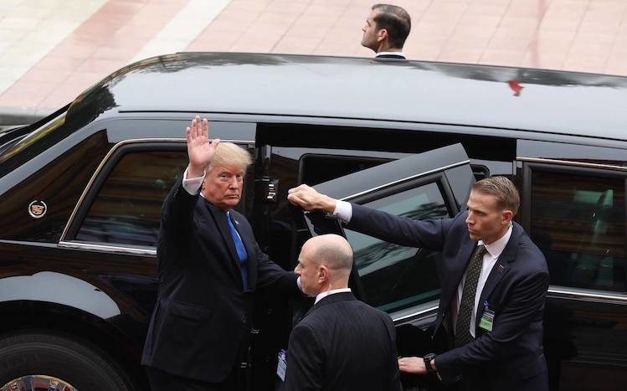
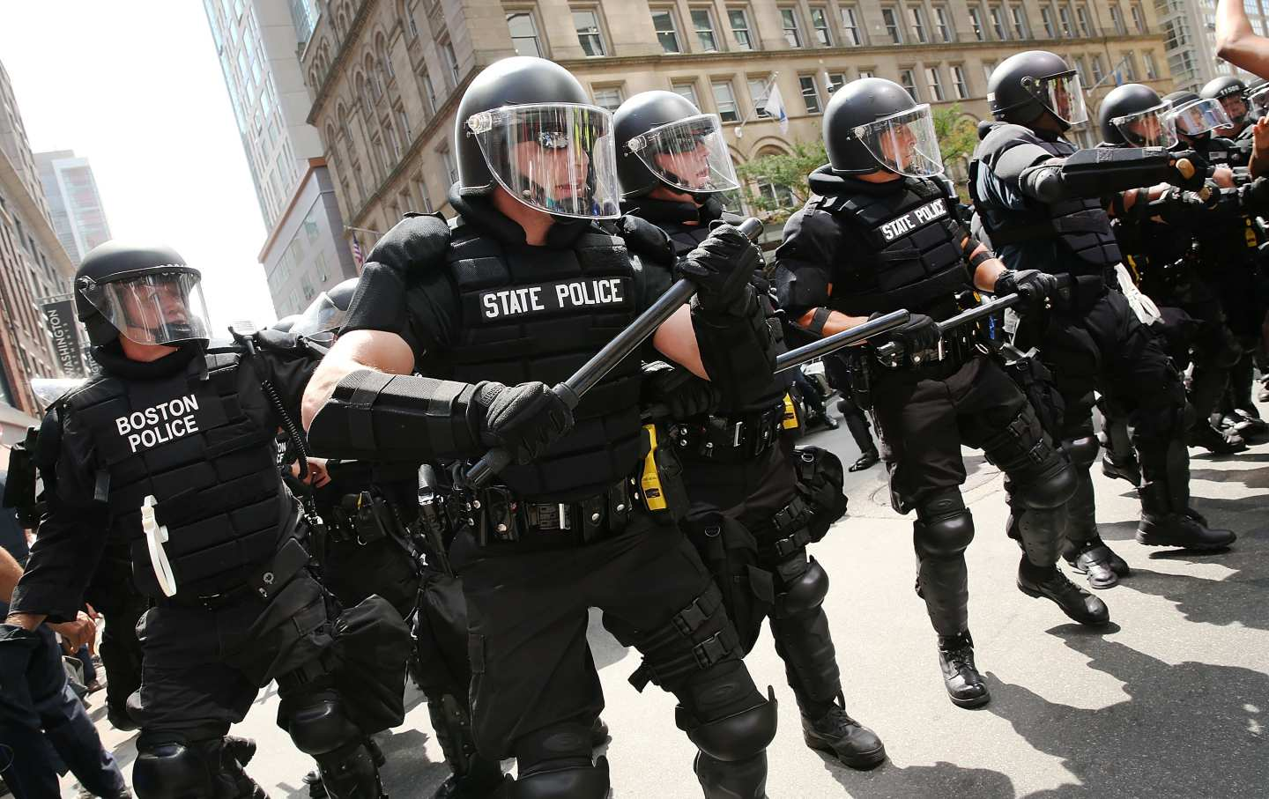
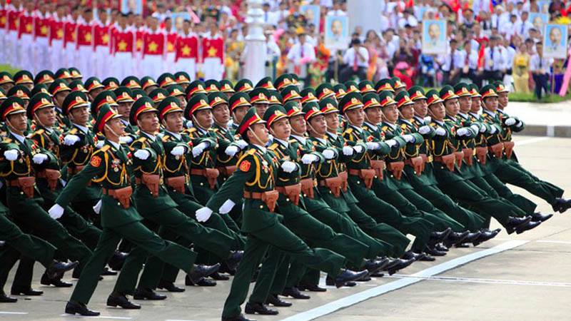

II. Customers
LGE Internal Use Only
Notes:
Therefore, We have carefully selected customers who are worthy of this product.

Slide 7
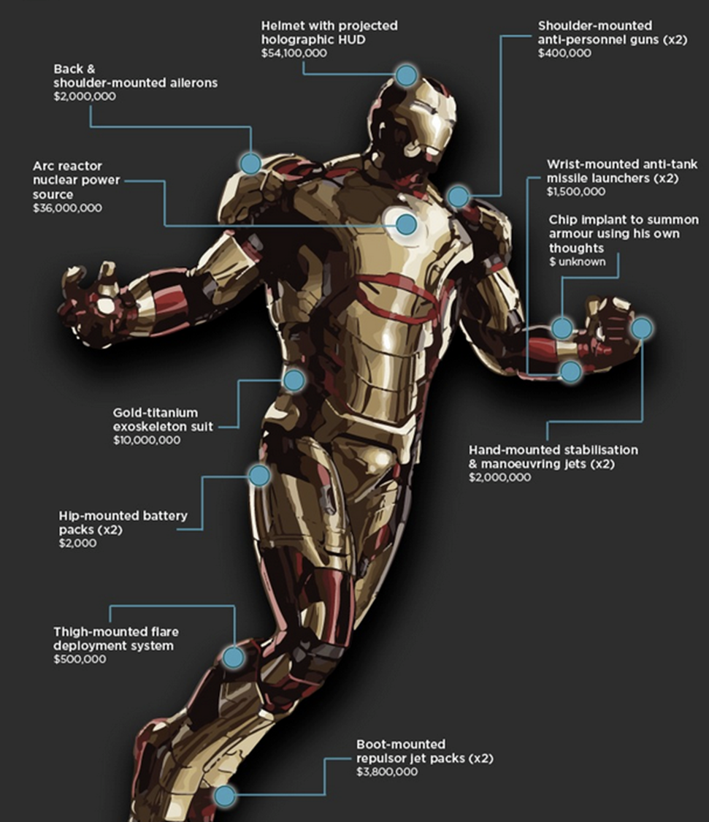
III. Product Features
LGE Internal Use Only
Protection
Notes:
The Iron Man suit provides the owner with enhanced protection through:
Durable armor/ˈɑːmə(r)/ plating. /ˈpleɪtɪŋ/
Reinforced structure for durability.
Force fields for defense.
Life support systems for extreme environments.
Emergency ejection system for quick escape.

Slide 8
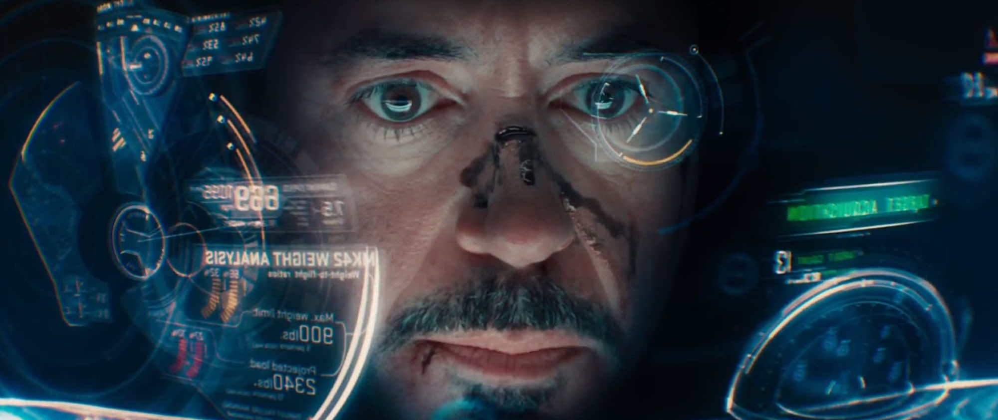
III. Product Features
LGE Internal Use Only
AI Combat Algorithm
Notes:
- Enhances the owner combat capabilities.
- Allows the AI system to analyze combat situations in real-time and provide tactical suggestions and assistance.
- Help the owner make informed decisions, identify weaknesses in opponents, optimize attack strategies, and react quickly to changing circumstances/ˈsɜːkəmstəns/.
- Enhances combat efficiency and situational awareness, giving the owner an edge in battles.

Slide 9
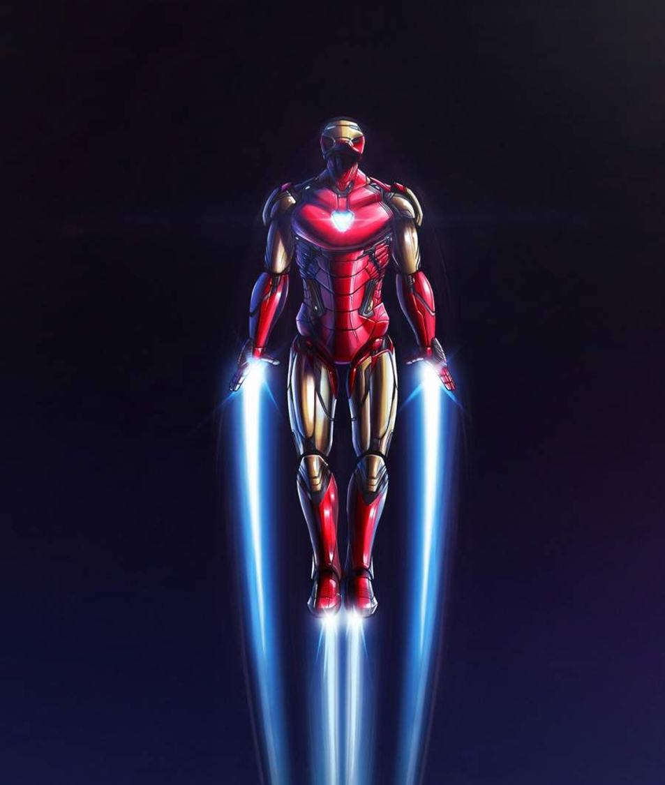
III. Product Features
LGE Internal Use Only
Movement system
Notes:
The Iron Man suit's movement system features:
Repulsor technology for flight.
2.AI assistance for piloting/ˈpaɪlətɪŋ/ and optimization.
3.HUD display for vital /ˈvaɪtl/ information.
4.Advanced sensors for situational awareness.
5.Flexible, articulated armor /ˈɑːmə(r)/ for mobility/məʊˈbɪləti/.

Slide 10
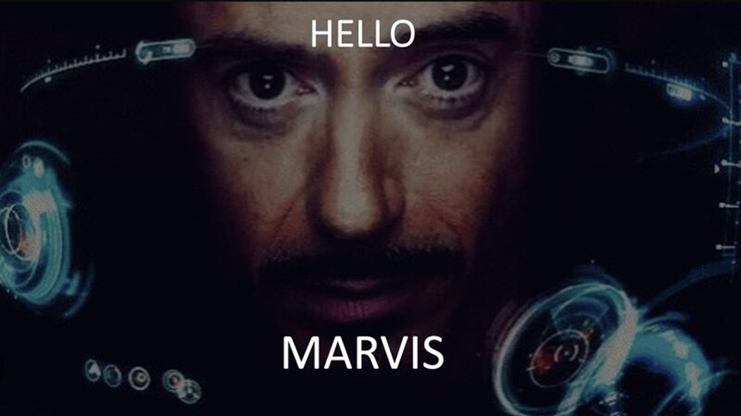
III. Product Features
LGE Internal Use Only
Jarvis Assistant
Notes:
- J.A.R.V.I.S. (Just A Rather Very Intelligent System) serves as the AI assistant within the Iron Man suit.
- It assists the owner with tasks like piloting /ˈpaɪlətɪŋ/ the suit, analyzing data, and providing real-time information and advice.
- J.A.R.V.I.S. is capable of understanding natural language commands and communicates with the owner through the suit's HUD (Heads-Up Display).
- Providing invaluable support in combat and everyday tasks.

Slide 11
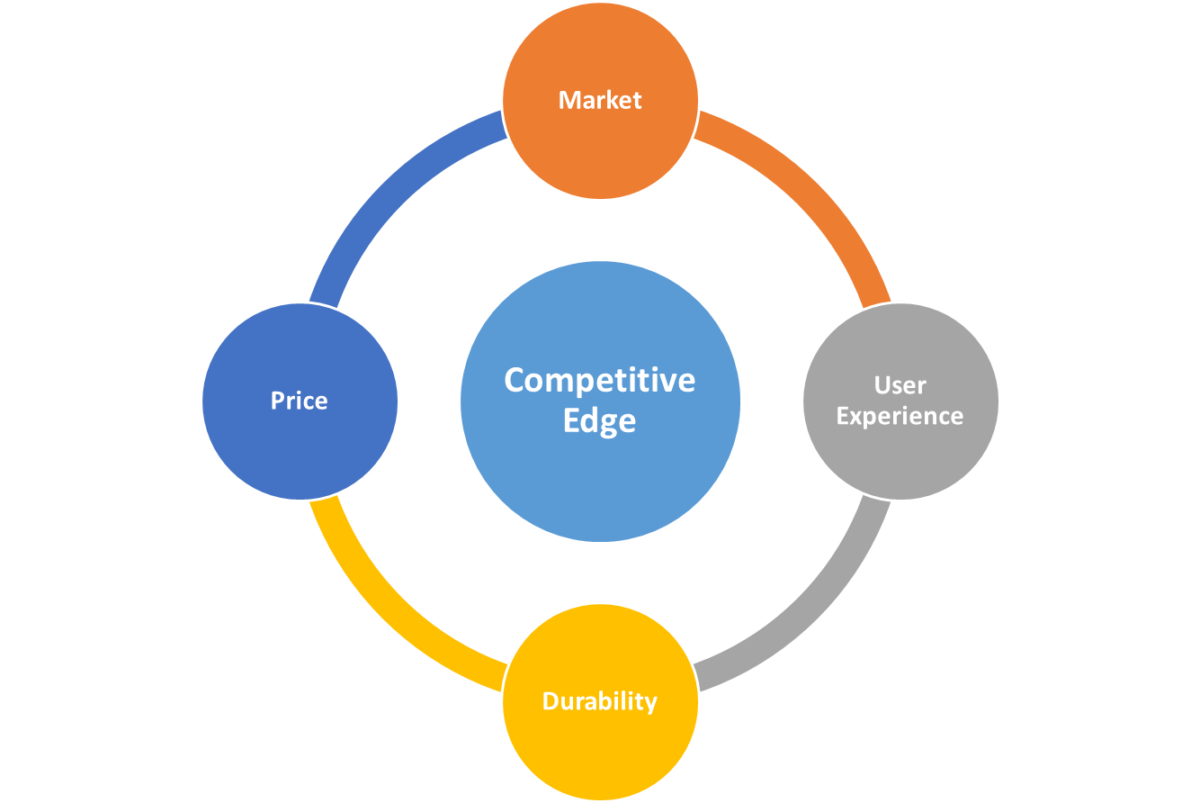

Slide 12
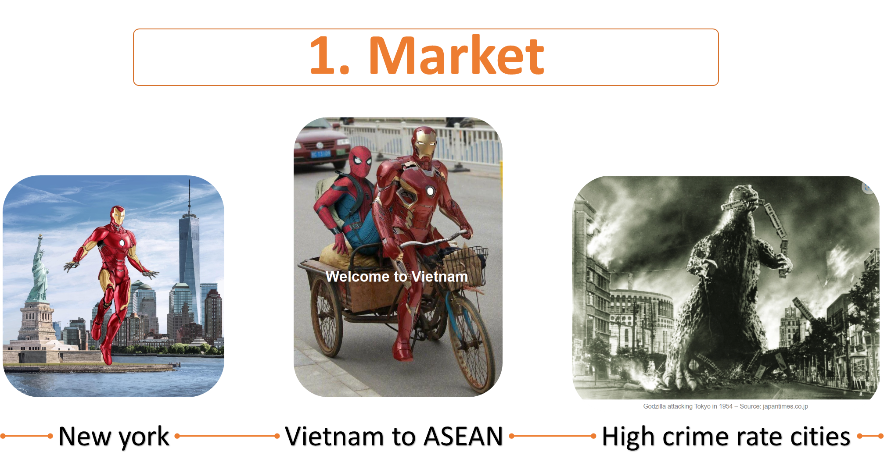

Slide 13
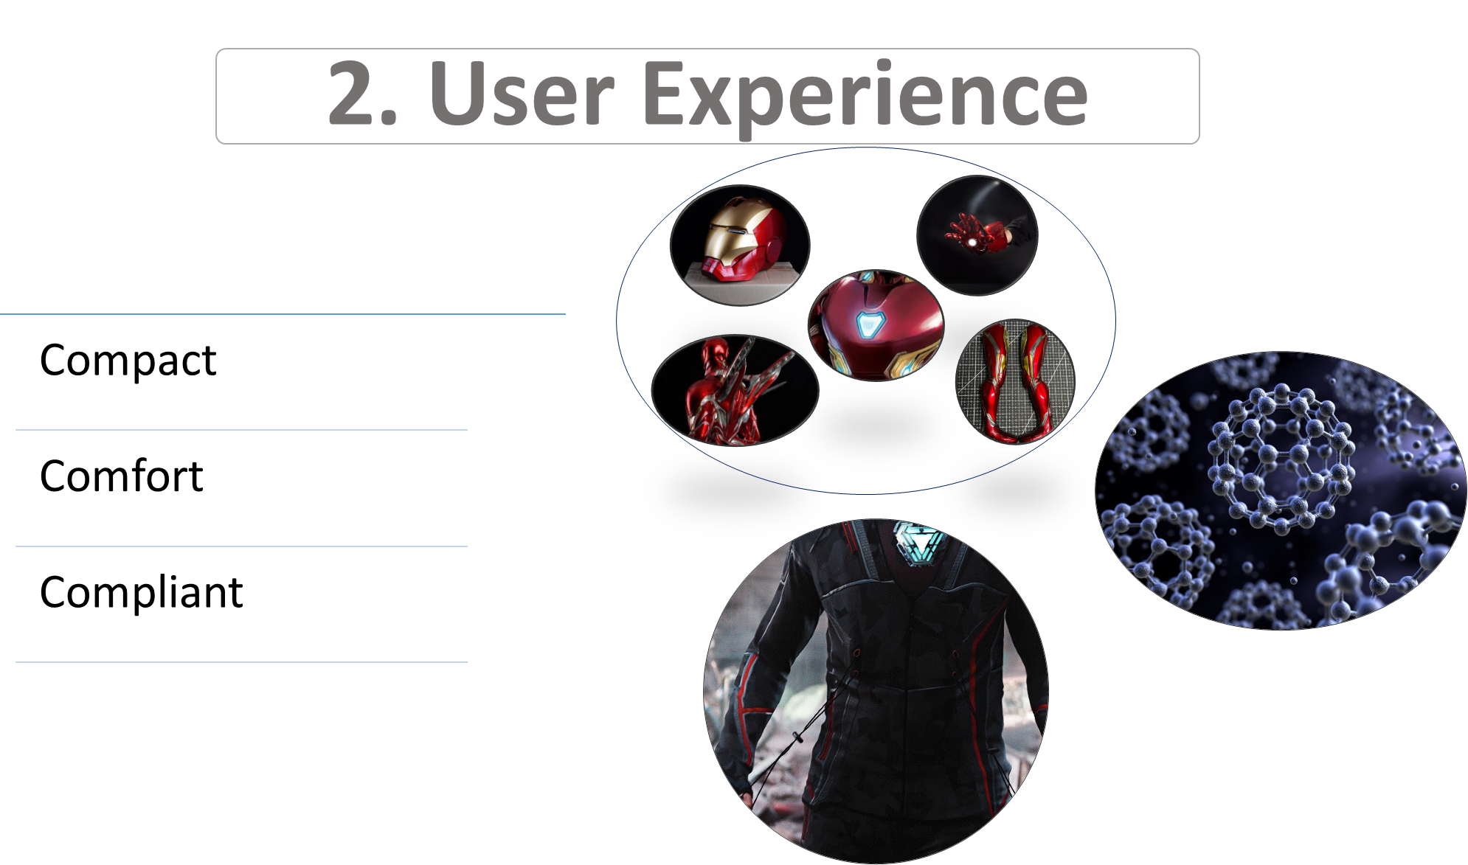

Slide 14
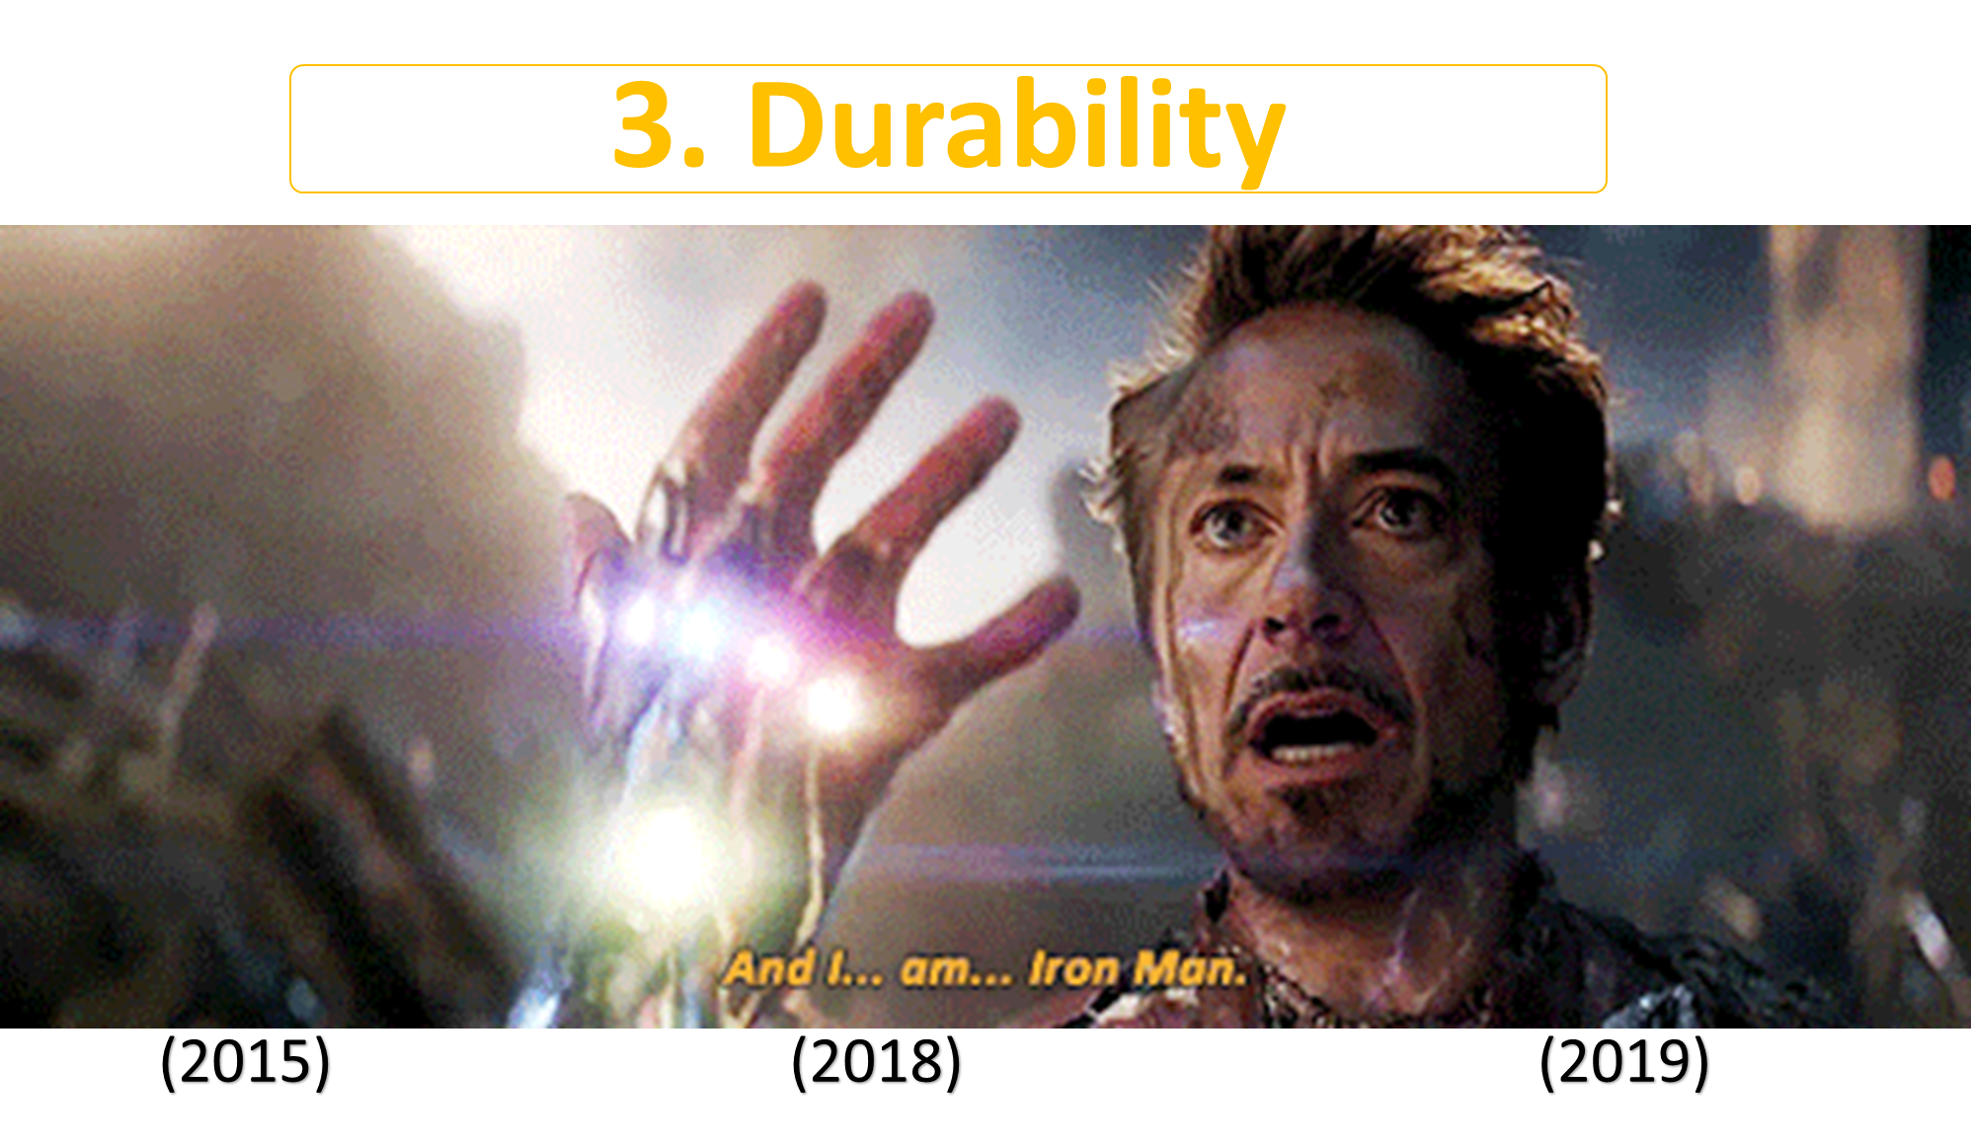

Slide 15
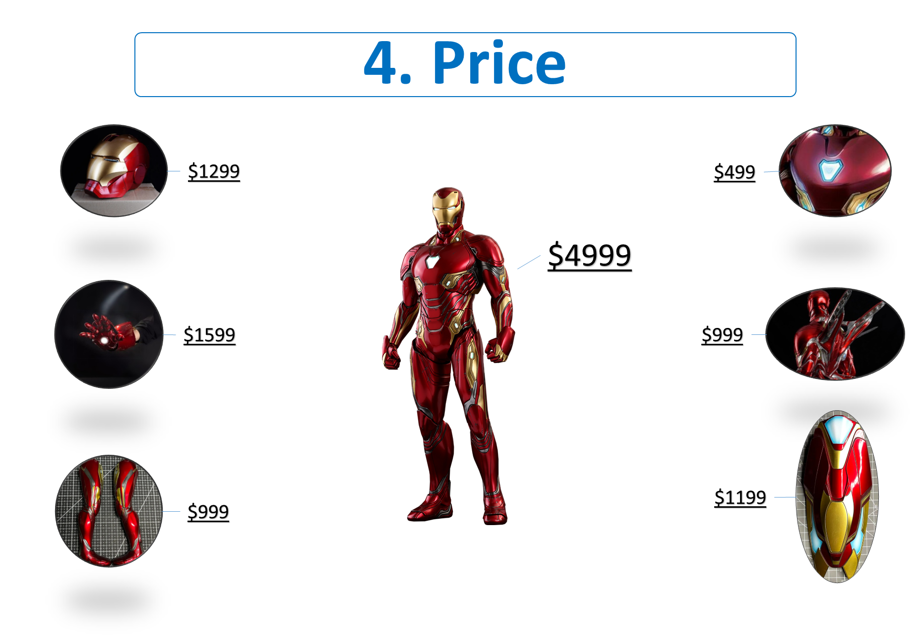

Slide 16


